Slide 1



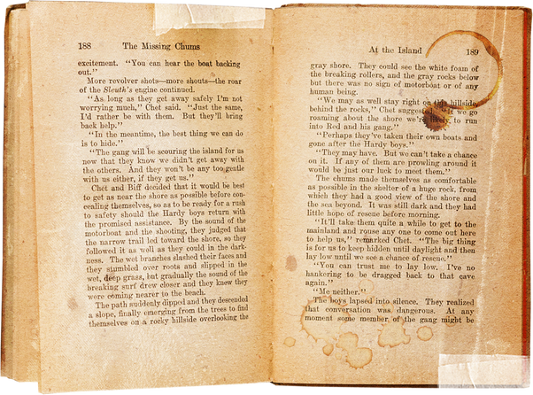






GOODREADS DATASET
And Dashboard
Presented by Menna Mostafa

Slide 2



OVERVIEW
•Good Reads:
Goodreads was founded in 2006. The idea came about when Otis Chandler was browsing through his friend's bookshelf. He wanted to integrate this scanning experience and to create a space where people could write reviews regarding the books that they read.

Slide 3

OVERVIEW
•Content
The reason behind creating this dataset is pretty straightforward,
listing the books for all book-lovers out there, irrespective of the language and publication and all of that.

Slide 4


ABOUT DATA-SET
This data was entirely scraped via the Goodreads API
it has :
18 columns
11.1k Rows
0 empty

Slide 5

COLUMNS
Title
Ratings Count
Authors
Text Reviews Count
AVG of Rating
Publisher
Language
Publication Date
Number of Pages
Genres

Slide 6
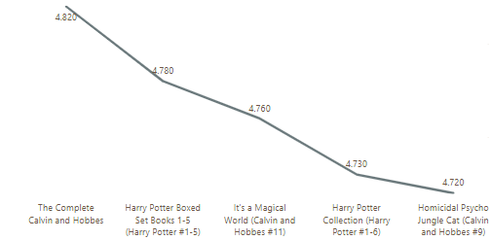
QUESTIONS OF THE DATASET
1-MOST 5 RATED BOOKS BY AVG RATING

Slide 7
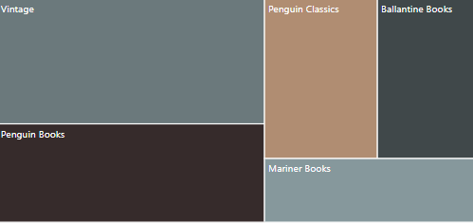
QUESTIONS OF THE DATASET
2-MOST POPULAR 5 PUBLISHERS BY AVG RATING

Slide 8
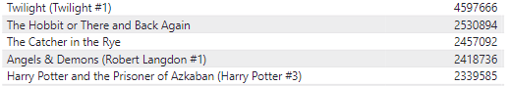
QUESTIONS OF THE DATASET
3-TOP 5 RATING COUNTS BOOKS

Slide 9
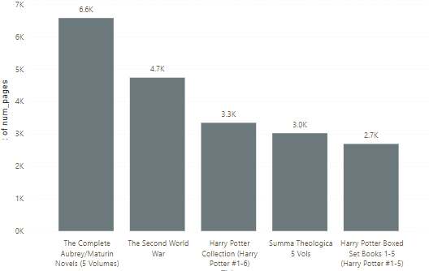
QUESTIONS OF THE DATASET
4-BOOKS WITH THE MOST NUMBER OF PAGES

Slide 10
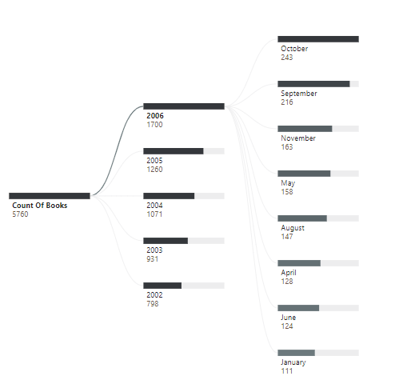
QUESTIONS OF THE DATASET
5- YEARS WITH THE MOST NUMBER OF PUBLISHED BOOKS

Slide 11
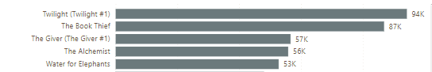
QUESTIONS OF THE DATASET
6-TOP 5 TEXT-REVIEWS BOOKS

Slide 12
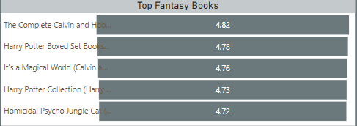
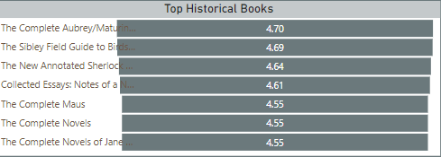
QUESTIONS OF THE DATASET
7-MOST RATED BOOKS BY GENRES

Slide 13
Now I hope you will be able to read the book that it’s to your liking and for more info you can see my Dashboard.

Slide 14
THANK
YOU

